Slide 1

File IO -Writing Files
M1-D16
Participate! The more engagement the better! You are NEVER interrupting me!

Slide 2
Objectives
File Reading
File Permissions
Input/Output Streams
File Buffering
PrintWriter/BufferedWriter

Slide 3
File IO
The java.io.File class is used when working with Files and the Filesystem. Ex: File text = new File("data/Dummy.txt");
The file object has a LOT of methods . Use intellisense or look at the java-io.file documentation for examples

Slide 4
Scanner
File text = new File("data/Dummy.txt"); try(Scanner fileScanner = new Scanner(text)) {
String firstLine = fileScanner.nextLine();
String[] mySplitLine1 = firstLine.split(" ");
.... do something with first line...
}
catch (Exception e) {
e.printStackTrace();
}
Putting Scanner inside a try block will not only handle any exceptions, it will also take care of closing the file.

Slide 5
File Permissions
File permissions are controlled by the operating system and indicate who or what has access to files. Read Write Execute

Slide 6
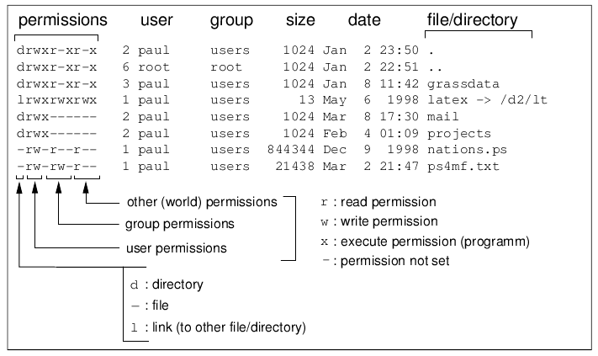
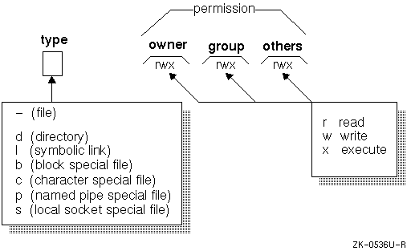
File Permissions

Slide 7
File Modes
-rwxrwxrwx | Indicates a File d Indicates a directory l Indicates a Link
-rwxrwxrwx | r has read permission w has write permission x has execute permission - does not have this permission for the slot it is in. | First Group is for the Owner of the File
-rwxrwxrwx | r has read permission w has write permission x has execute permission - does not have this permission for the slot it is in. | Second Group is for users that are members of the same user group as the owner of the file
-rwxrwxrwx | r has read permission w has write permission x has execute permission - does not have this permission for the slot it is in. | Third Group is for all other users

Slide 8
File Operations
JavaDoc
exists() | boolean - does the file or directory exist
isDirectory() | boolean - returns true if the path points to a directory
isFile() | boolean - returns true if the path points to a file
getName() | Returns the name of the file or directory
getAbsolutePath() | Returns the absolute path of the file or directory
mkdir() | Creates a new directory in the specified location
createNewFile() | Creates a new File in the specified location

Slide 9
Writing Files

Slide 10
PrintWriter
BufferedWriter
File file = new File(pathToFile);
try(PrintWriter writer = new PrintWriter(file)) { writer.println(text); writer.flush();
}
java.io.PrintWriter
JavaDoc
File file = new File(pathToFile);
try(PrintWriter writer = new PrintWriter(file)); BufferedWriter buffered = new BufferedWriter(writer)) {
buffered.write(text);
}
java.io.BufferedWriter
JavaDoc
Capstone Tip: https://beginnersbook.com/2014/01/how-to-append-to-a-file-in-java/

Slide 11
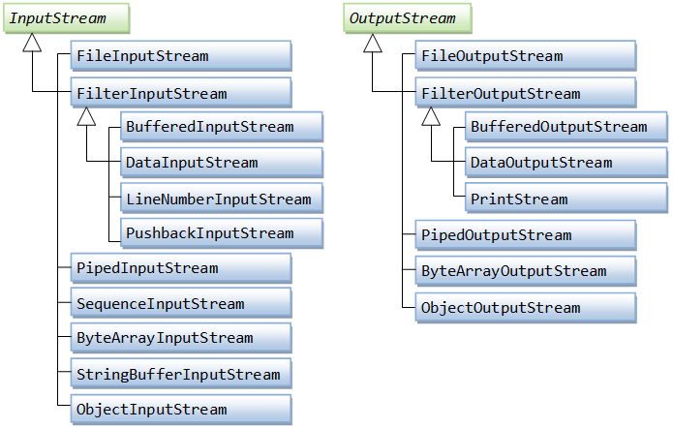
Other Input/Output Streams
Scanner
PrintWriter

Slide 12
File Buffering
File Buffering
File Input/Output operations consume a lot of important resources and are time consuming. Hence, writing a chunk (batch) of characters to a file is faster than writing one character a time. It speeds up the I/O process.
To do this, we use buffers (BufferedWriter, etc)
Analogy
A buffer is like a bucket you catch water in. Once the bucket is full, you can dump it out, ready to be filled again.

Slide 13
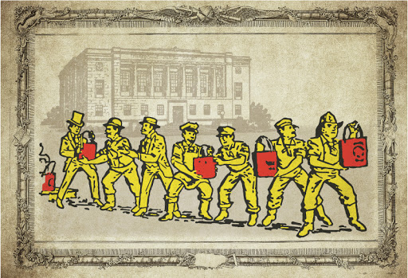
File Buffering
Content is buffered and not saved (or cannot be seen) until the stream is flushed or disposed.
The flush() method of PrintWriter Class in Java is used to flush the stream. By flushing the stream, it means to clear the stream of any element that may be or maybe not inside the stream

